Slide 1
Do Fast-Food Chains Price Discriminate on the Race and Income Characteristics of an Area?
Final Presentation: Econometrics I
Presented By:
Jehanzeb Shahzad
Abdul Rehman Shoukat
Zain Khan
Mirza Kashif
Muhammad Usman

Slide 2

Introduction
This article reports tests for differences in prices charged by fast-food restaurants that serve markets with customers of widely divergent incomes and ethnic backgrounds.
Do Fast-Food Chains Prices Discriminate on the Race and Income Characteristics of an Area?

Slide 3
Methodology and Descriptive Statistics
Data on individual fast-food restaurants were gathered in a study by Card and Krueger (1994) that investigated the effect of a minimum-wage change in New Jersey on employment in the fast-food industry.
In their study, Card and Krueger attempted to contact all Burger King, KFC, Wendy's, and Roy Rogers restaurants that were listed in all of New Jersey and eastern Pennsylvania.
The total number of observations/samples was 410.

Slide 4
Methodology and Descriptive Statistics (cont.)
Obtained a complete set of price data for 387 stores in the first phase of the survey and for 376 stores in the second phase of the survey.
The survey contained questions on a variety of store characteristics, including the number of employees, wages, and ownership status.
Also, zip-codes were used as the original price data with census data by zip-code region which is relevant for the density and crime-rate statistics.

Slide 5

Regression Equation
Piz is the price of an item in store i in zip code z
Rz is a vector of variables representing the race and income characteristics of zip code z
COMPiz is a vector of variables controlling the competition faced by store i in zip code z,
MCiz is a vector of variables related to the marginal cost of operation of store i in zip code z
€ is the error term

Slide 6
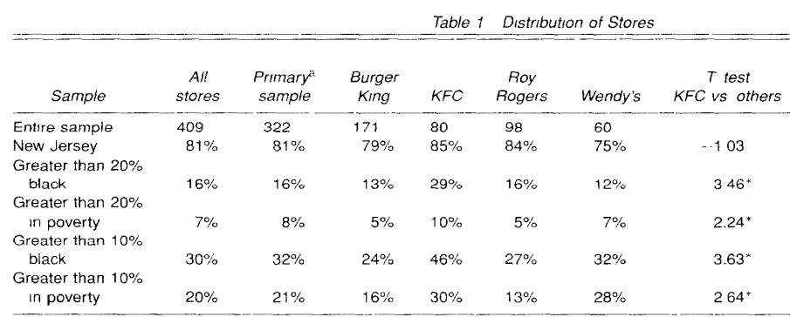
Distributions of fast food stores
The table presents the percentage of stores located in areas with different race and income compositions
Prop Black = Black people/everyone
Proportion below poverty: pop below poverty/ Pop for which poverty is determined
Cut off points of 20% and 10% are arbitrary
Average percentage of black people across a zip code is 11.4%
Average percentage of poor people across a zip code is 7%

Slide 7
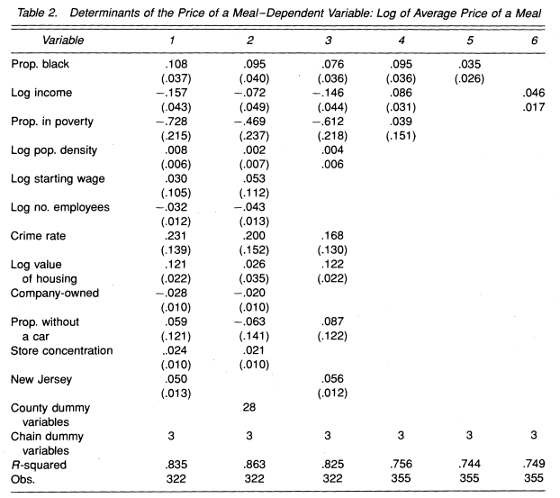
Variables
The entree, soda, and fry prices are summed to determine the meal price
1 unit change in independent variable will bring about a b1*100% change in dependent variable (log-level)
if we change x by one percent,
we’d expect y to change by β1 percent (log-log)
R*100% variation in Y is explained by the model.
Problem: restaurants of the same chain may have supplied prices for different types of items

Slide 8
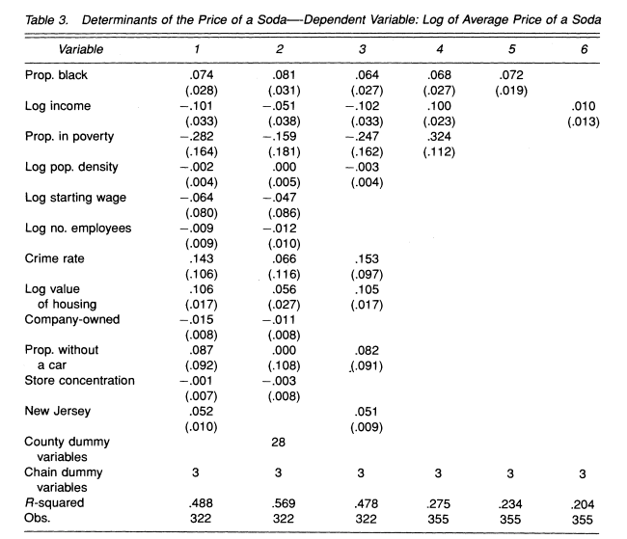
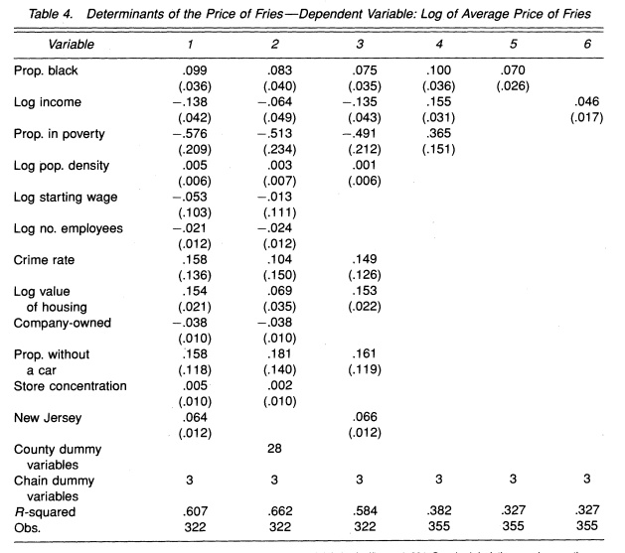
Isolating Commodities

Slide 9
Reasons why prices differ in black areas
According to the data, prices in black areas are higher regardless of income or cost controls
prices rise about 5% for a 50% increase in the black population, even after controlling for differences in cost and competition
Cost Explanation: differences in prices are arising because of unmeasured cost differences that are correlated with the proportion-black variable (crime rate – insurance costs are high & less branches in black vicinity by owners so less economies of scale and less price reductions)
Imperfect Competition: Differences in demand elasticities – Female labor participation – working mothers are less sensitive to price
Discrimination: white workers/ customer are prejudiced against black workers Young (1994)

Slide 10
Conclusion
The results indicate that fast food restaurants charge more in neighborhoods occupied by the Black community.
For every 50% increase in the population of blacks in a area price are increased by 5%.
  The difference might be due to unmeasured costs in the area populated by the Black community.

Slide 11
Relevance to Developing Countries
Prices are relatively higher in Developed Countries.
Prices are almost same in Developing Countries.
Price discrimination across race in Pakistan is not there, might be due to less diversity.

